Slide 1

Online shopping for Women Site
Hunde Melat
Student Id:-
2017080108

Slide 2
WE ARE SUNDAY MARKET
Sunday Market has seen some remarkable accomplishments over the past 30 years. With a goal to become an $8 billion company by 2025 and open 600 stores in the next three years, it’ll be exciting to see the company achieve in three years what it initially took 30 years to do. Did you know... Sunday Market is the 5th largest specialty retailer in the United States. "

Slide 3
Background
Sunday Market ecommerce stores or websites, may be the next future of shopping. this ecommerce websites may be the reason for the closing down of the physical stores and malls. This web world contains the lots of beautiful and incredible online shopping website. Various online shopping stores deals in different categories like clothes, jewelry, handbags, perfumes &optical etc. today on web you can find lots of ecommerce stores sell products at high or cheap price, so you are in lots of confusion from where to buy & when to buy. so to remove your confusion we did research and get some great online shopping ecommerce websites that helps you to buy a quality product at fair cost.

Slide 4

Features
Home
About us
Product
Shop
Our Service
Contact us
My Account

Slide 5
Technologies
* HTML
* CSS
* Front end
* Back end
* Bootstrap
* JavaScript
* Node.js
Features
User side- Add products to cart,
Place an order,
Request their desired products
Admin side-
Manage Inventory, Manage Users

Slide 6
MATERIALS to be used for this App
HTML
CSS
BOOT STRAP
NODEJS

Slide 7
Plan Project
1.Frontend
WEEK 8 Create Github account
WEEK 9 Readme file
WEEK 10 Making home page responsive
WEEK 11 Completion of Front-End
WEEK 12 Frontend Optimization and URL from Glitch

Slide 8
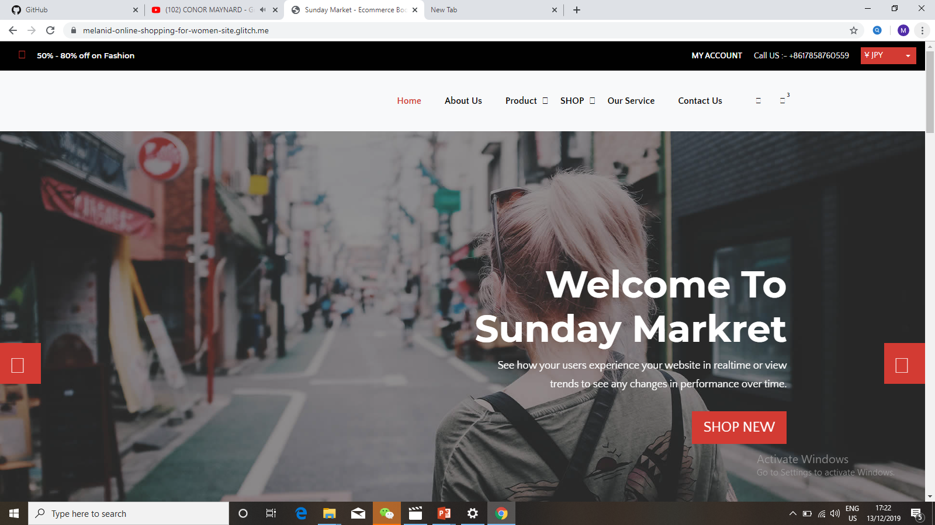

Slide 9
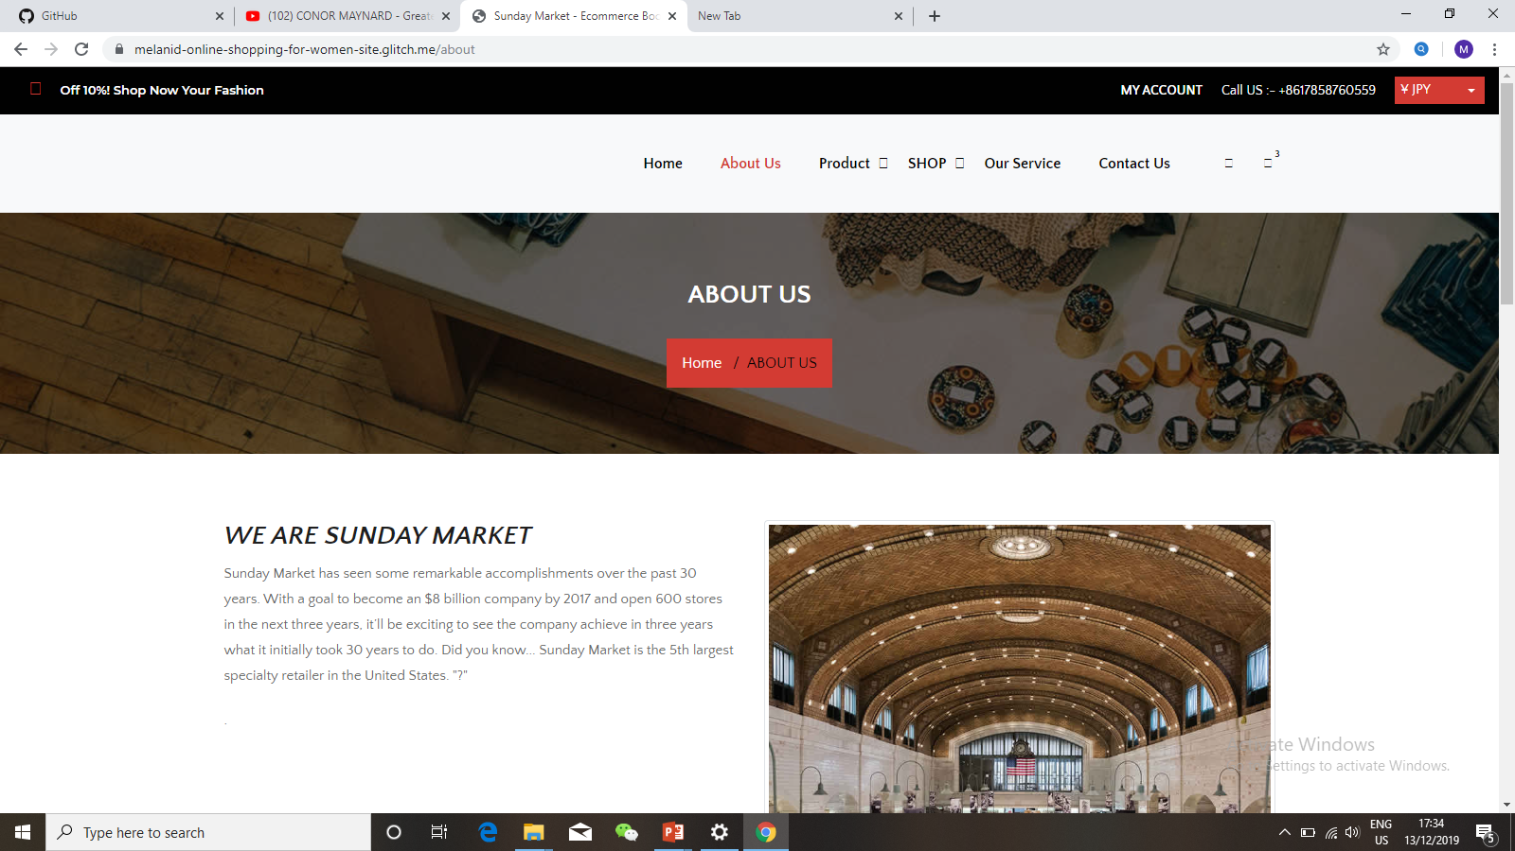
MY WEBSITE

Slide 10
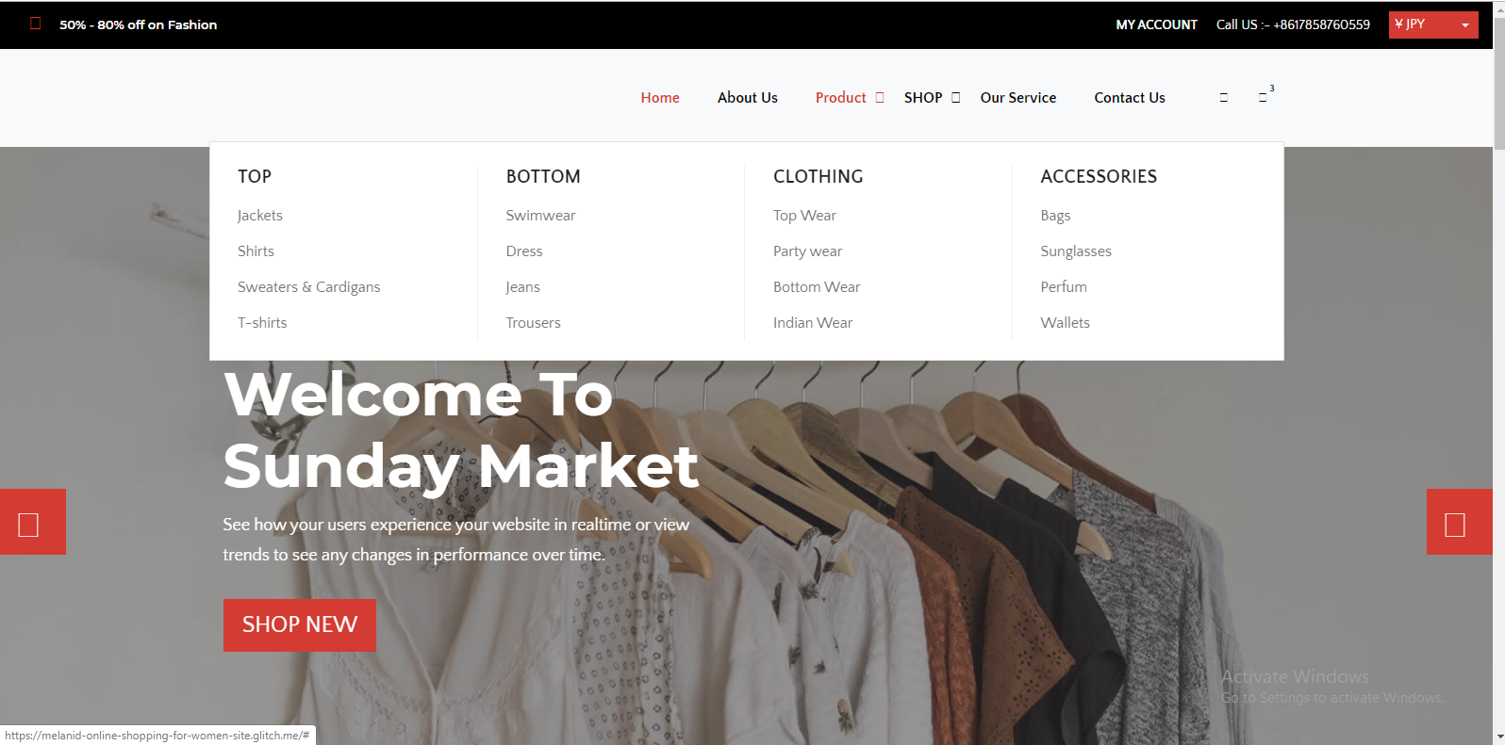

Slide 11
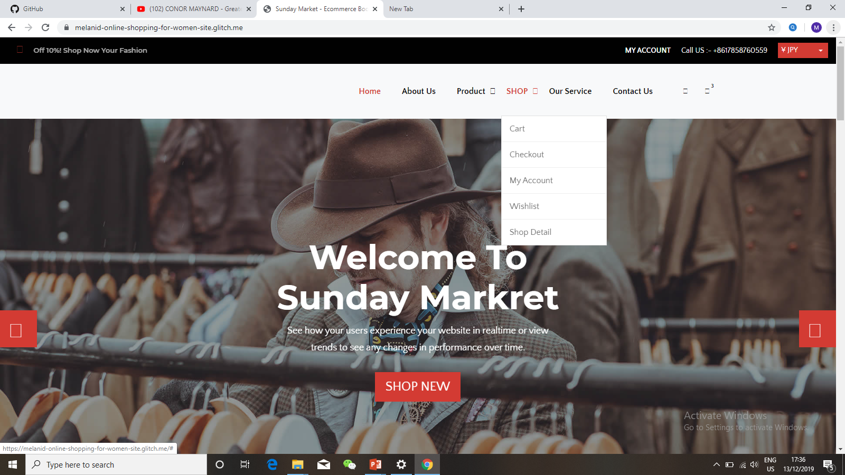

Slide 12
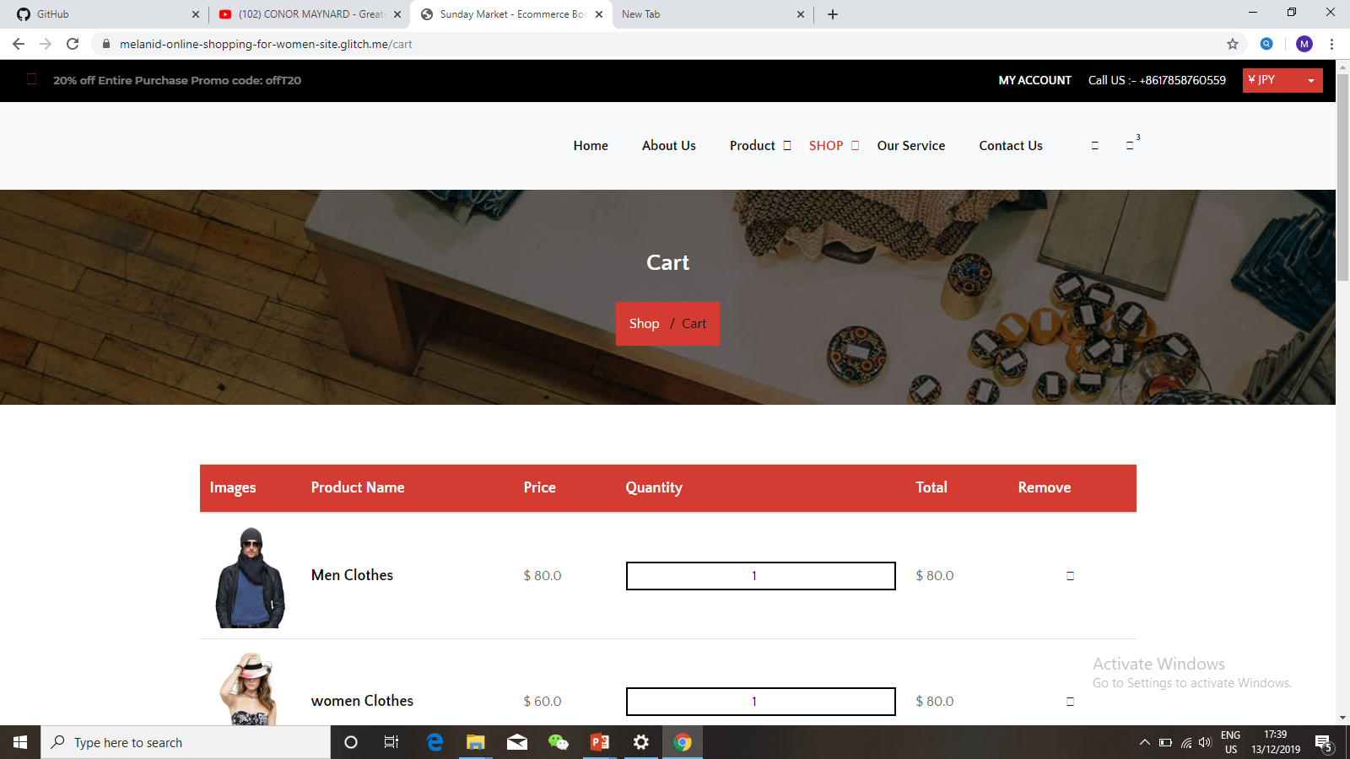

Slide 13
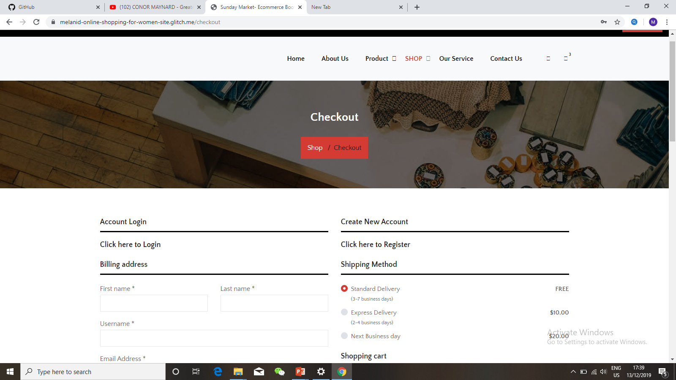

Slide 14
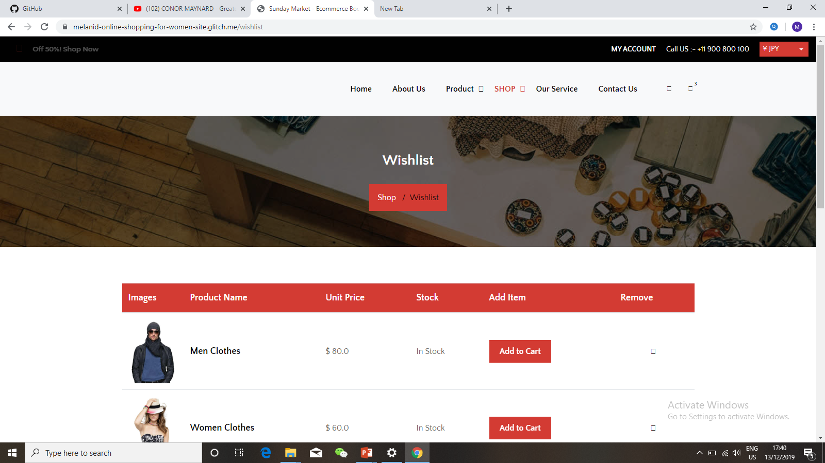

Slide 15
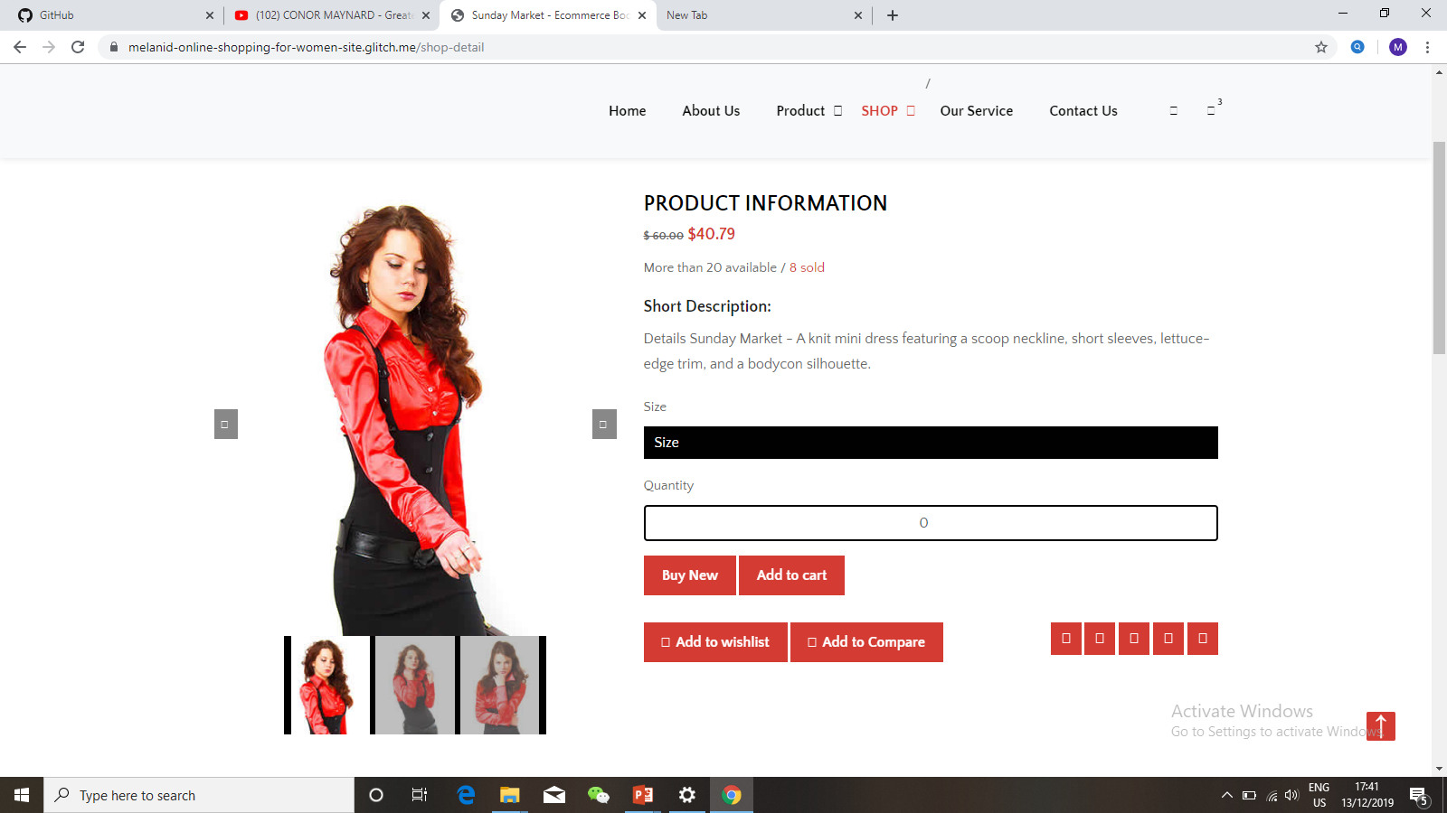

Slide 16
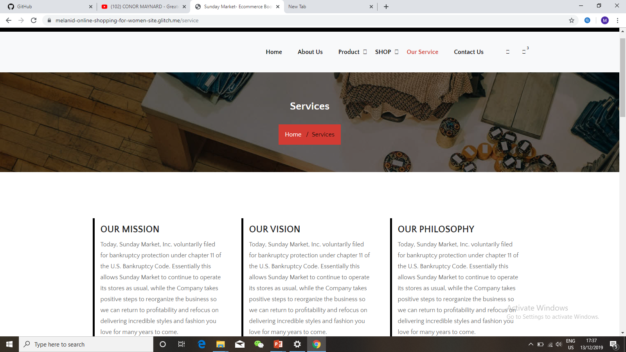

Slide 17
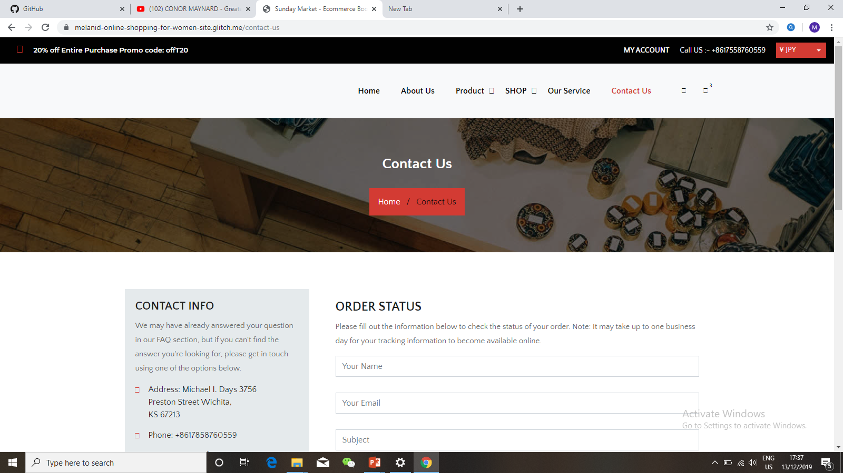

Slide 18
Plan Project
2.Backend
WEEK 13 Update Backend Features
WEEK 14Getting ready the user account with back end technology.
WEEK 15 Create and Delete method has been implemented from CRUD operation
WEEK 16 finished the CRUD operation

Slide 19
